Slide 1


Analyzing Traffic congestion through Time series analysis
Group members:
Jay Rathod 202201255
Karnik Rathva 202201266

Slide 2
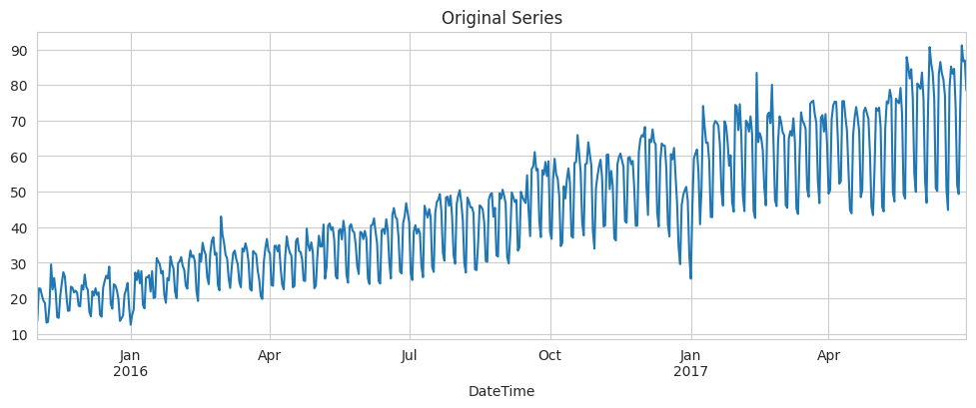
Dataset description
Hourly Traffic Dataset of USA
Daily number of vehicles plot

Slide 3
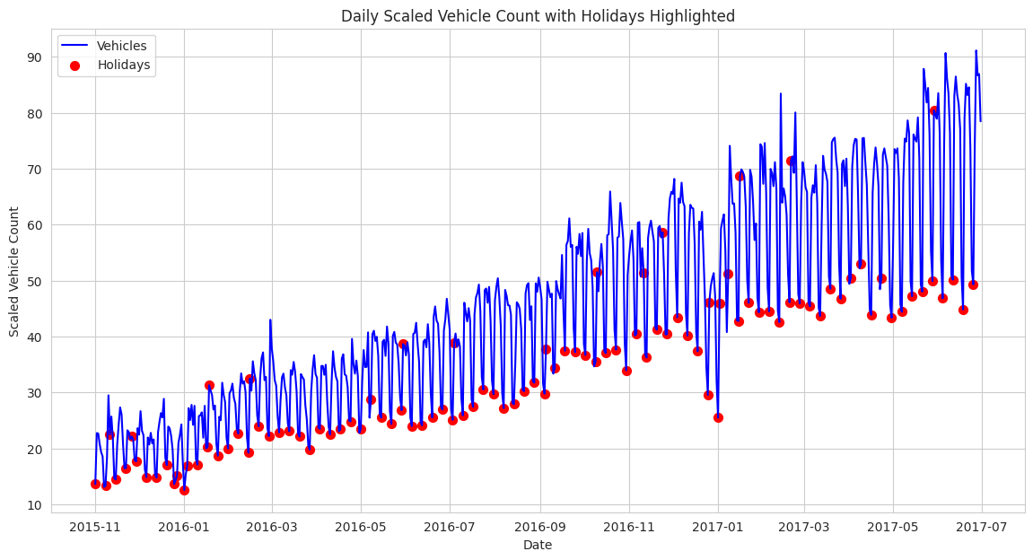
Relation between holidays
Average vehicle count on holidays: 33.98
Average vehicle count on non-holidays: 47.34
Percentage difference: 28.21%

Slide 4
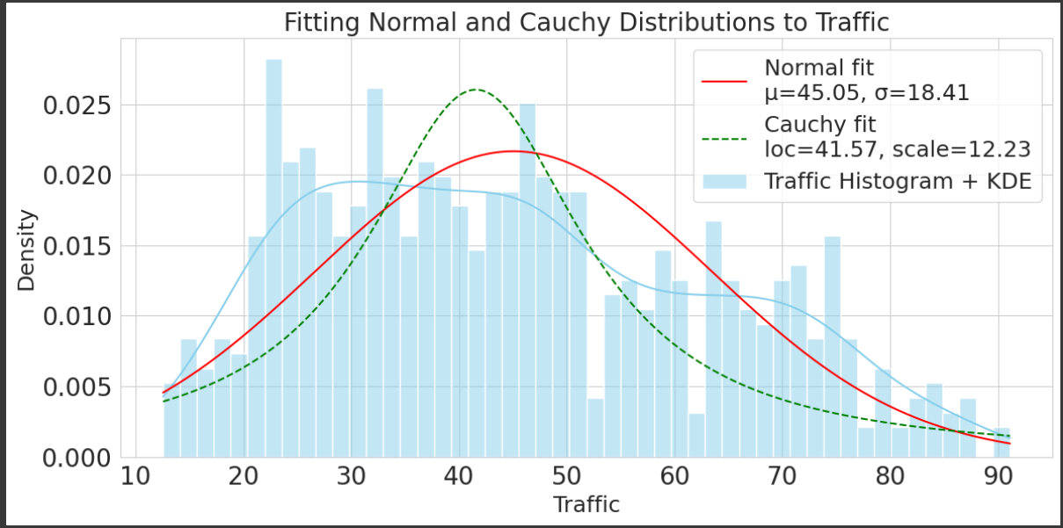
Normal and Cauchy distribution fitting

Slide 5
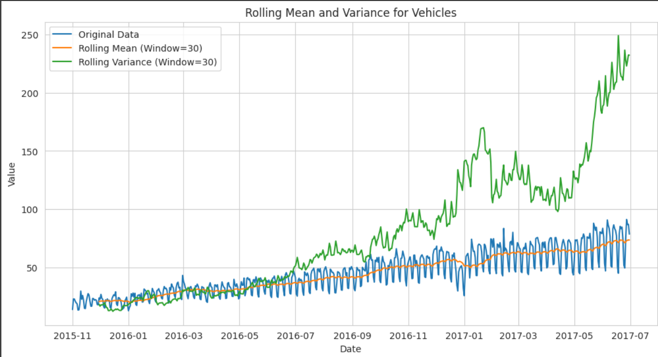
Rolling mean and Variance

Slide 6
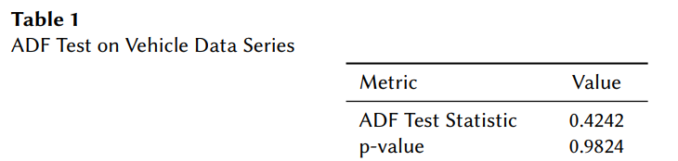
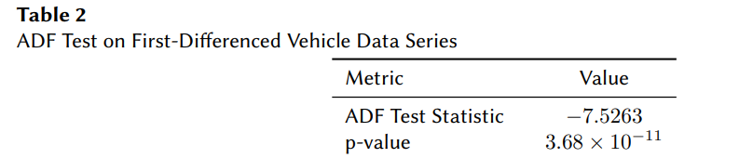
ADF Result

Slide 7
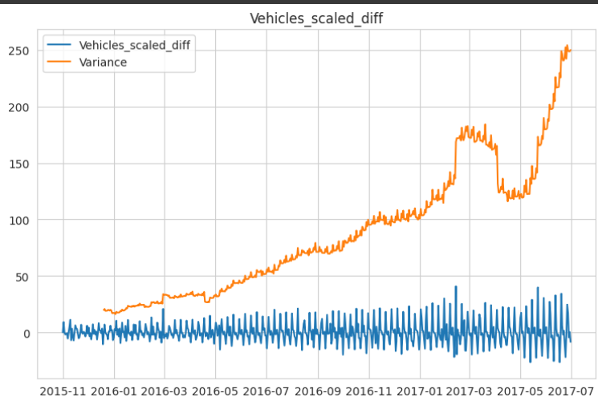
Variance After taking 1st Difference

Slide 8
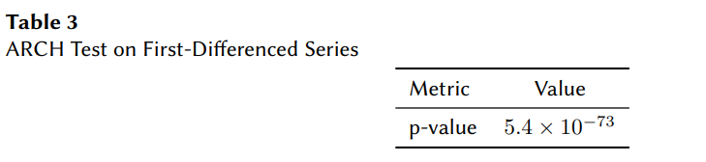
Heteroskedasticity
Since our p value of ARCH test is less than 0.05, we can say we have time-dependent varience.
That is why we need different transformation method.
Here we had taken log transformation, square root transformation , box-cox transformatin and box-cox difference transformation.

Slide 9
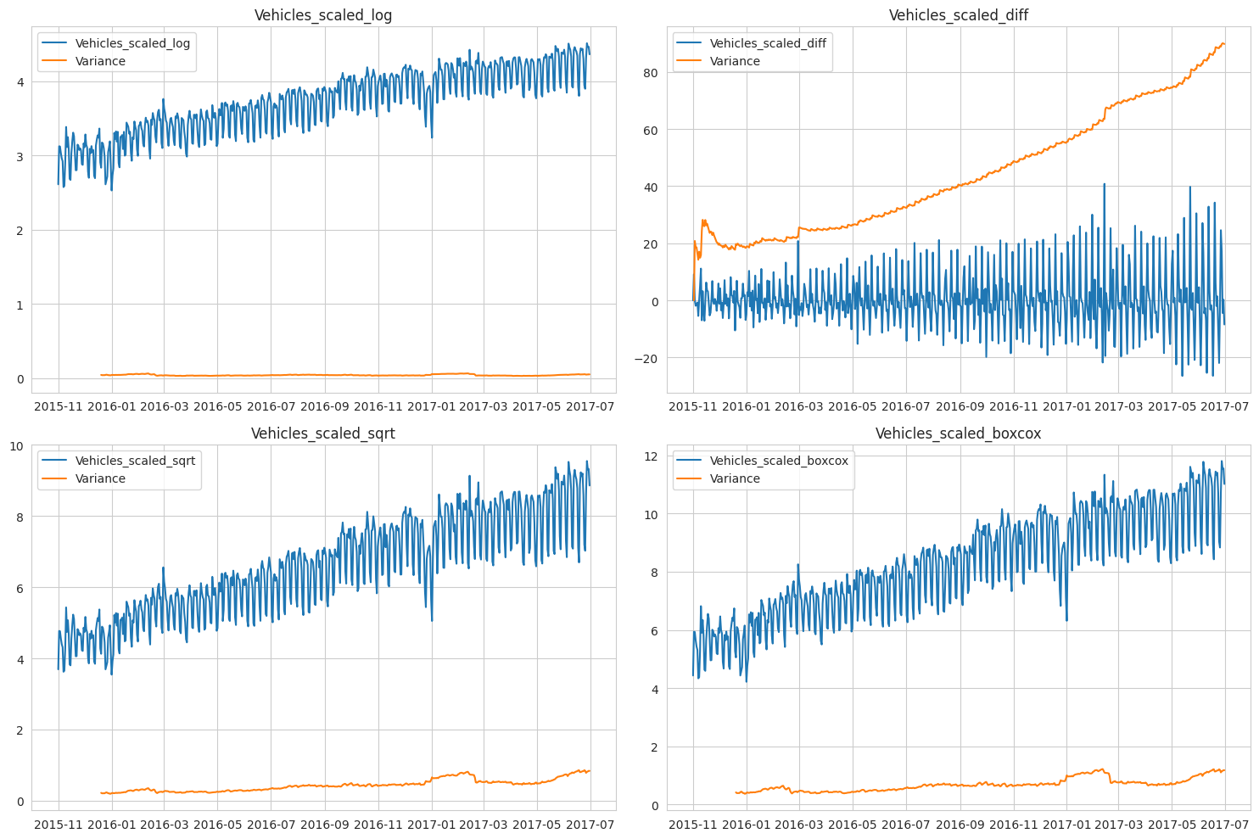
DIFFERENT TRANSFORMATIONS ON DATA TO
STABILIZE VARIANCE

Slide 10
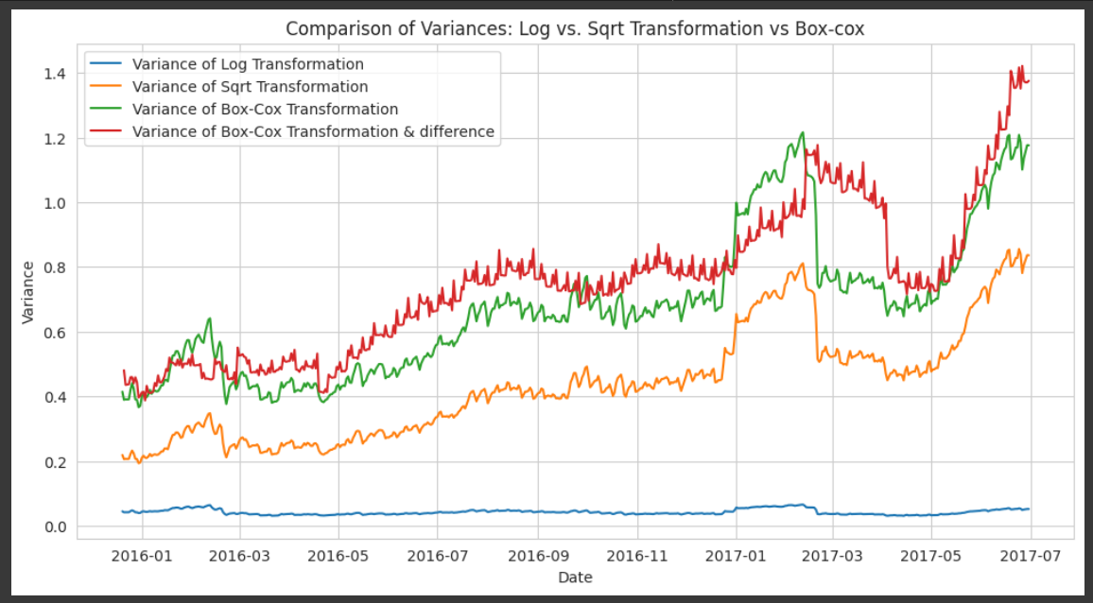
Comparison between transformartion

Slide 11
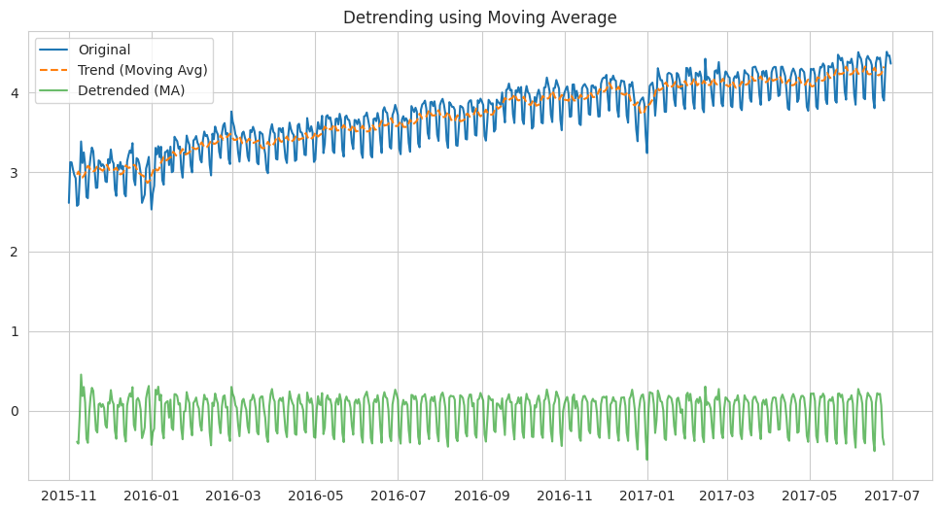
Detrending using MA

Slide 12
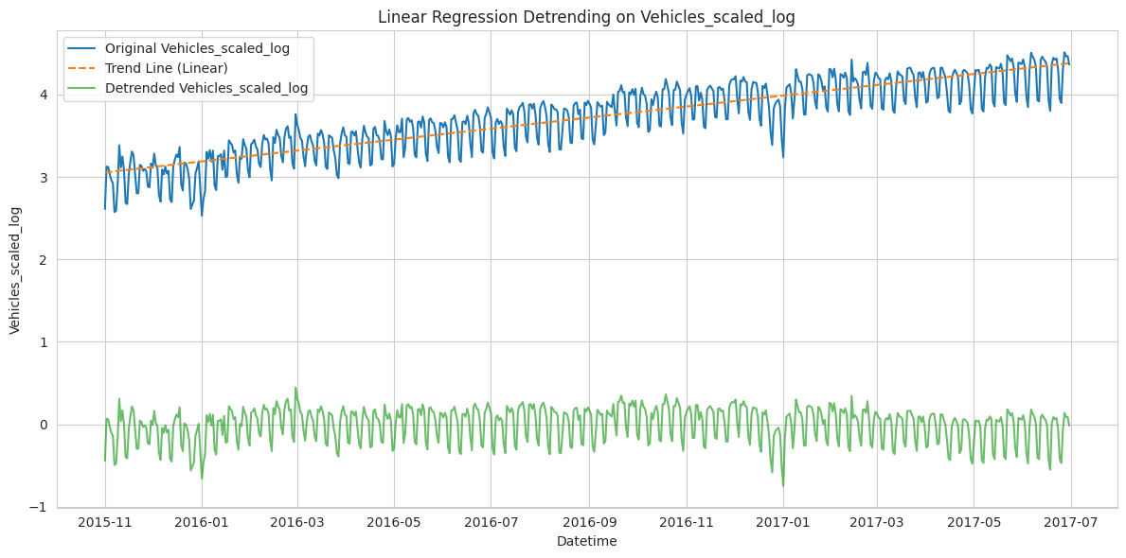
Detrending using Linear regression

Slide 13
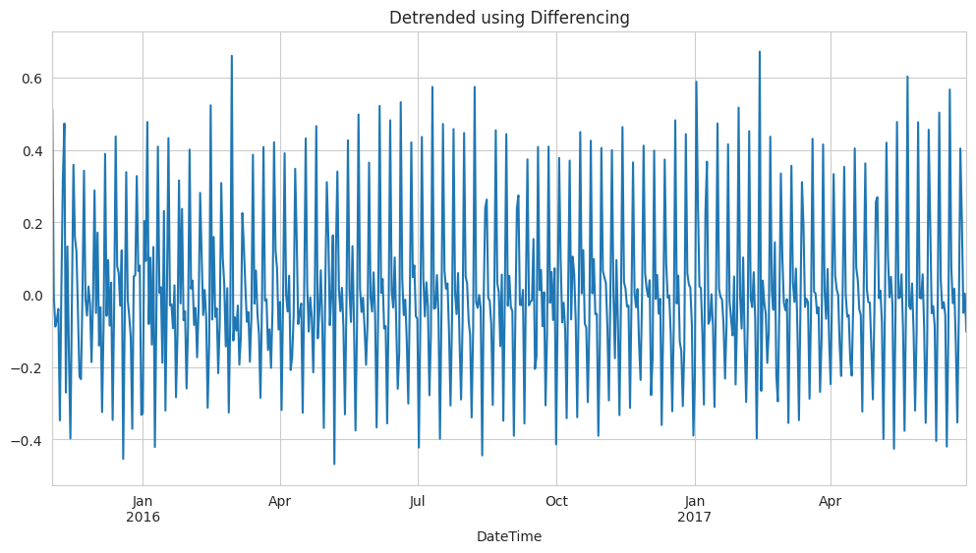
Detrending using Differencing

Slide 14
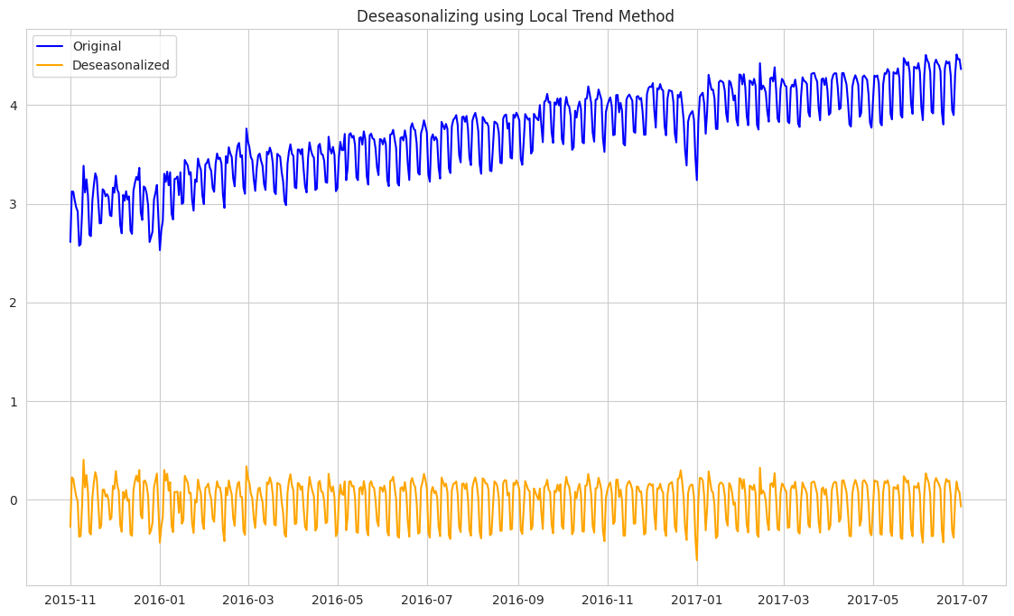
Deseasonalizing using local trend

Slide 15
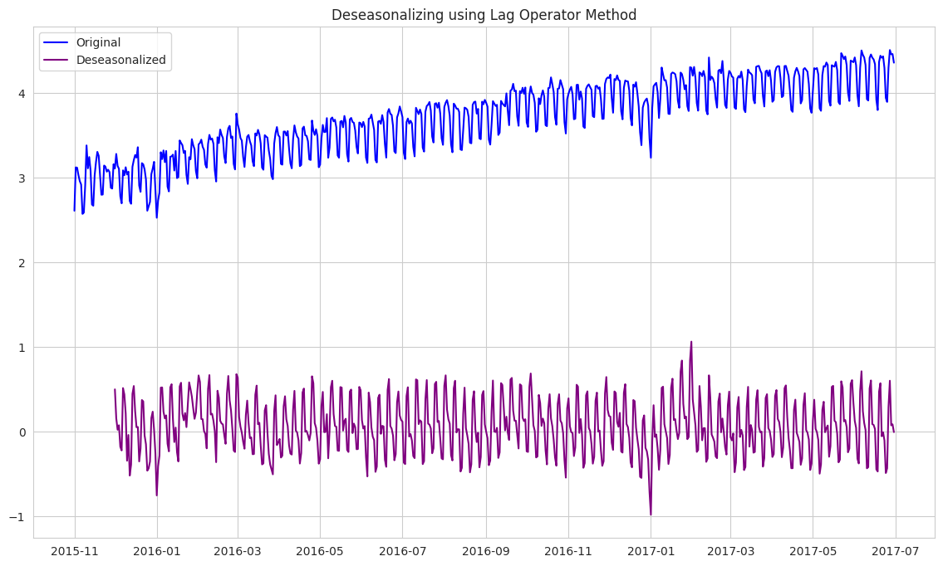
Deseasonalizing using Lag operator

Slide 16
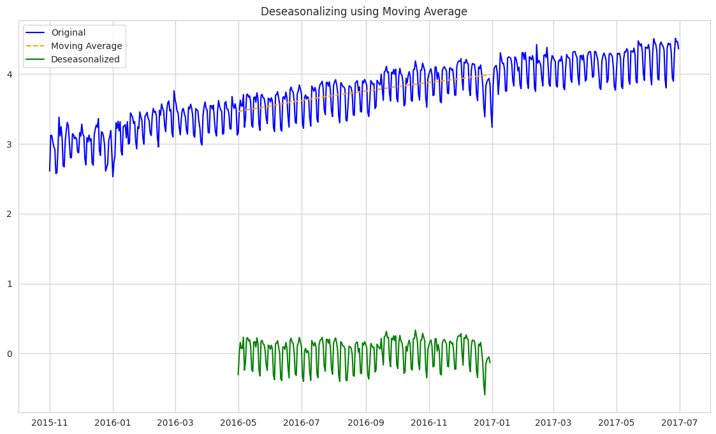
Deseasonalizing using MA

Slide 17
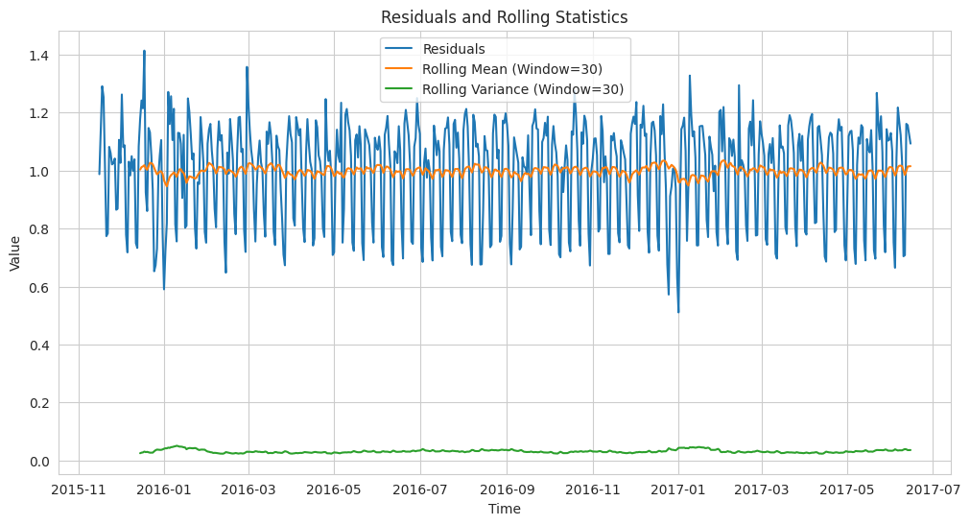

Slide 18
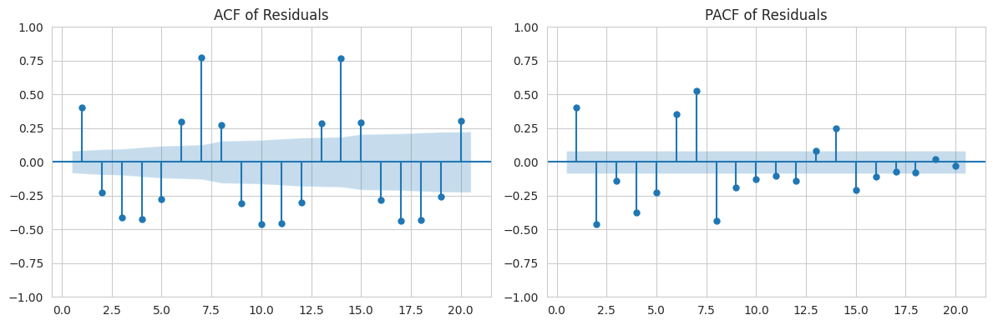

Slide 19
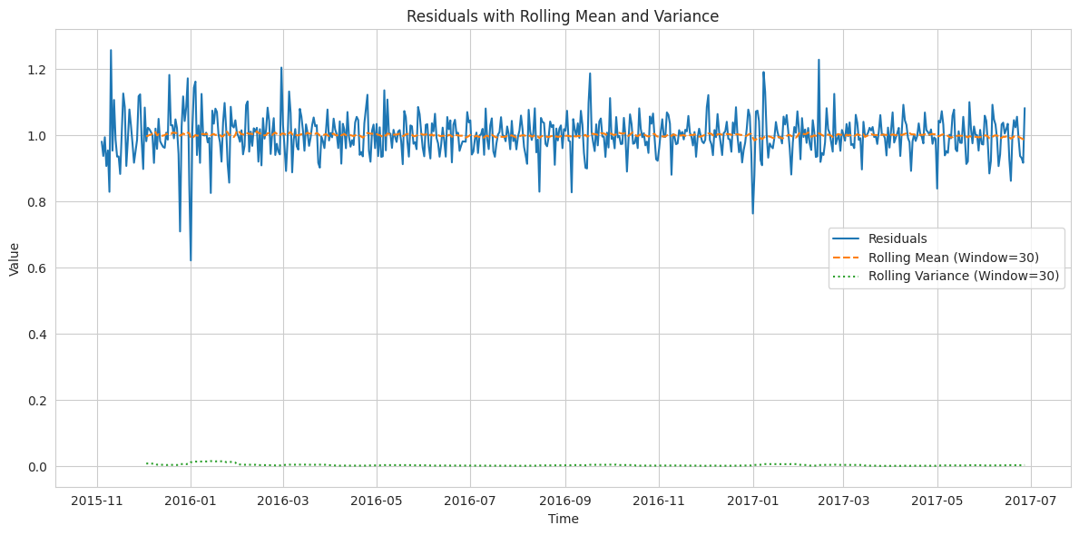

Slide 20
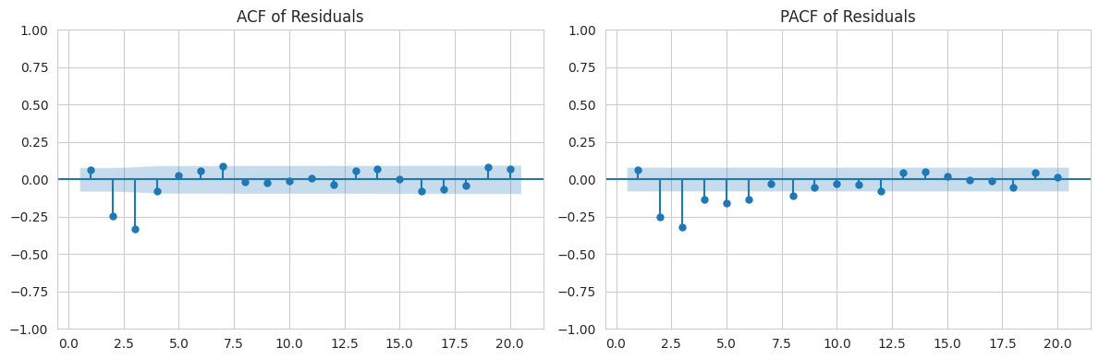

Slide 21

Conclusion
Our study applied time series analysis to urban traffic data, revealing weekly seasonal patterns and non-stationarity in raw data. Various transformations and decomposition techniques were used to stabilize variance and isolate components.
Thank you very much!

